Slide 1
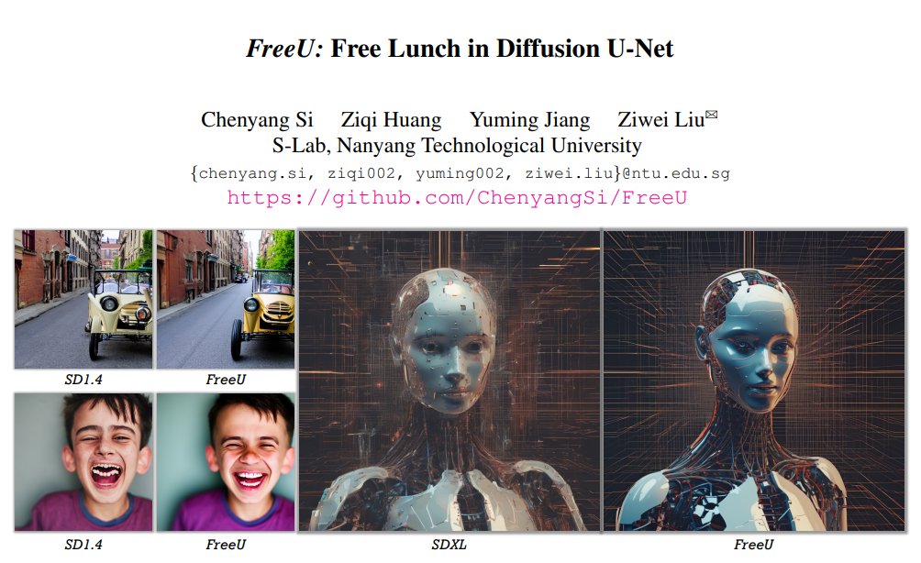
ID:113598045
Name:林翡
Notes:
Hellow everyone, Today, the paper I will be presenting is FreeU:Free lunch in diffusion U-Net.

Slide 2


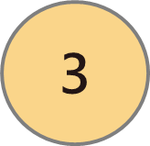

Outline
Introduction
Methodology
Experiments
Conclusion
1
Notes:
This is outline.

Slide 3
1. Introduction
2
Notes:
The first one is the introduction.

Slide 4
Diffusion model and U-Net background
Diffusion Models are generative models, meaning they are used to generate data similar to the data they were trained on.
They are composed of two key processes:
Diffusion process
Denoising process
U-Net is the core architecture of the diffusion model, which uses encoders and decoders (backbone network) as well as skip connections for denoising.
3
Notes:
First, I want to introduce the Diffusion model and U-Net background.
In the diffusion process, Gaussian noise is gradually added to the input data and eventually corrupts it into approximately pure Gaussian noise.
During the denoising process, the original input data is recovered from its noise state through a learned sequence of inverse diffusion operations

Slide 5
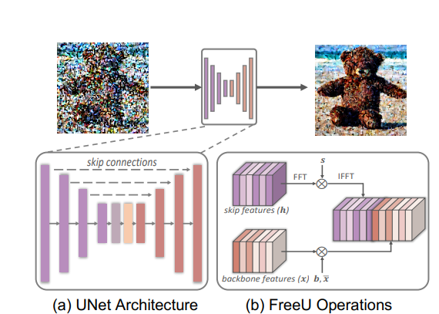
FreeU Framework. (a) U-Net Skip Features and Backbone Features. (b) FreeU Operations.
4

Slide 6
What's the problem?
The main backbone of the U-Net primarily contributes to denoising.
Skip connections introduce high-frequency features to help detail recovery (such as edges and textures).
However, it may weaken the denoising ability of the backbone network, resulting in a decrease in image generation quality.
Because too many high-frequency features may interfere with the construction of low-frequency semantics, leading to an imbalance in the image generation process.
5
Notes:
This part discusses the problems of using the U-net architecture. First, we introduce the functions of the backbone and skip connections.
The main ….
Skip…
However… because…
What is the low and high frenquency?
Low-frequency features are mainly responsible for the overall structure and color distribution of the image (such as object outlines, background).
High frequency features are responsible for details (e.g. edges, texture).

Slide 7
Research objectives
In order to balance the feature contributions of the backbone and skip connections of the U-Net architecture.
Introducing a strategy called “FreeU”. Utilizes two specialized modulation factors:
The backbone feature factors. → Texture oversmoothing problem.
Skip feature scaling factors. → Alleviate the problem of texture oversmoothing.
6
Notes:
Because of the problems mentioned above, it is necessary to balance the feature contributions of the backbone and skip connections of the U-Net architecture.
They introduced the FreeU architecture and used two modulation factors, one is the backbone feature factor, which aims to amplify the feature map of the backbone to enhance the denoising process, but there will be a problem of over-smoothing of the texture, so another skip feature scaling factor is needed to alleviate this problem.
The benefit of FreeU is the potential to improve sample quality without the computational overhead of additional training or fine-tuning

Slide 8
2. Methodology
7

Slide 9
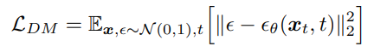
How to Generate Images from Noise During Denoising Process
Generating samples from a diffusion model is initiated by sourcing from a Gaussian noise distribution and subsequently following the inverse diffusion process pθ(xt−1|xt).
A trajectory sequence xT , xT −1, ..., x0 ending with the generated sample x0.
The sampling process depends on the denoising model ϵθ to eliminate noise.
The optimization objective of denoising model.
8
Notes:
This part is how to Generate Images from Noise During Denoising Process.
First, explain the generation process of the diffusion model. Starting from the Gaussian noise distribution, the input data is pure noise data without any semantics or structure. Next, the model enters the inverse diffusion process, which is the noise removal process. Following this formula, the formula is the probability of generating the previous stage data xt-1 given the current data xt.
Next is the trajectory sequence. The entire generation process can be expressed as a trajectory sequence from Gaussian noise to clear image, xT represents the initial pure Gaussian noise, and x0 is the final generated clear sample.
While actually performs the denoising operation is ϵθ, which is the denoising model. Its goal is to learn to remove unwanted noise at each step while preserving important features of the image.

Slide 10
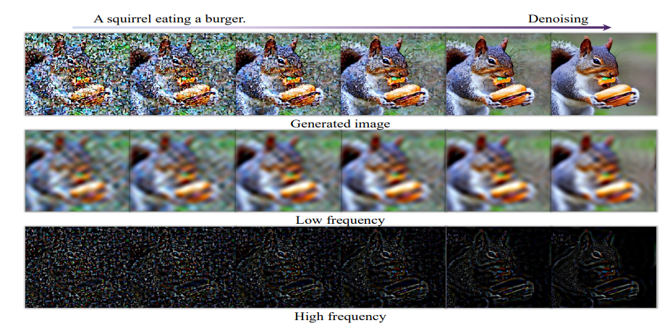
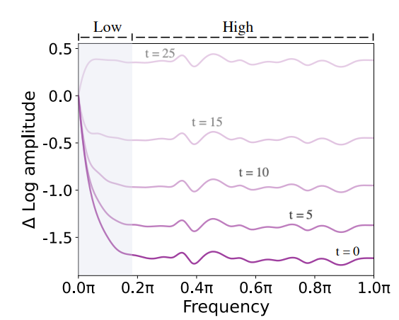
Low frequency: Changes slowly during the denoising process, gradually stabilizing the image structure.
High frequency: Show more obvious changes.
Denoising process visualization
Relative log amplitudes of Fourier
9
Notes:
This part is to observe the difference between low-frequency and high-frequency features in the denoising process.
From Denoising process visualization, the uppermost row provides the progressive denoising process, showcasing the generated images across successive iterations. The subsequent two rows exhibit the associated low -frequency and high-frequency spatial domain information after the inverse Fourier Transform, aligning with each respective step.
We can see obvious high-frequency changes, because denoising mainly targets high-frequency noise.
And from the Relative log amplitudes of Fourier, it is observed that the amplitude of high-frequency components decreases rapidly
Therefore, the denoising process needs to eliminate noise while retaining the indispensable(不可或缺的) complex details

Slide 11
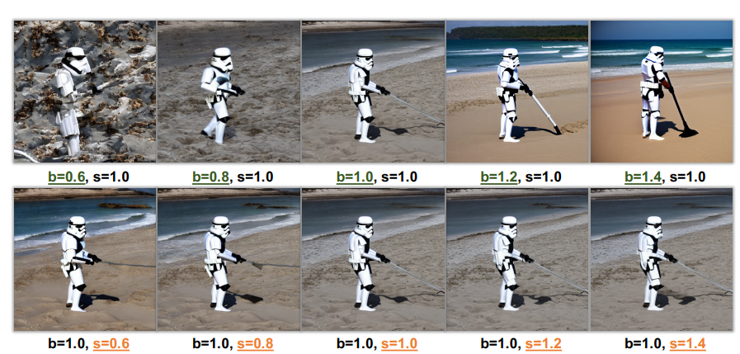
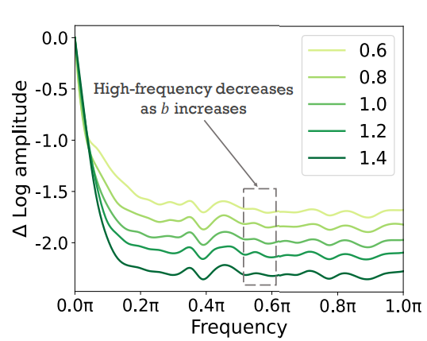
How does Diffusion U-Net Perform Denoising
Two multiplicative scaling factors b and s are introduced to modulate the feature maps generated by the backbone and skip connections respectively.
Effect of backbone and skip connection scaling factors (b and s)
Relative log amplitudes of Fourier with variations of the backbone scaling factor b
The primary role of the U-Net backbone network is to filter out high-frequency noise.
10
Notes:
This part is How does Diffusion U-Net Perform Denoising
Researchers conduct a controlled experiment to introduce two multiplicative scaling factors b and s to modulate the feature maps generated by the backbone and skip connections respectively.
Left figure is effect of backbone and skip connection scaling factors,We can see to increase the scale factor b of the backbone significantly increases the quality of image generation. When b equals 0.6, the generated image still has a lot of noise, but when b equals 1.4, it can generate clear image. However, adjusting the scaling factor s of the skip connection has a limited impact on the quality of the generated image.
Right figure is Relative log amplitudes of Fourier with variations of the backbone scaling factor b,we can see the corresponding increase in b results in the suppression of high-frequency components in the images produced by the diffusion model.
Through two figures, we can see that the main function of the U-Net backbone network is to filter out high-frequency noise.

Slide 12
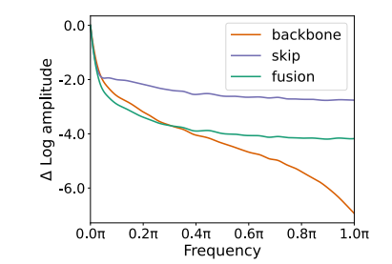
The features transferred by skip connections are mainly high-frequency information.
Fourier relative log amplitudes of backbone, skip, and their fused feature maps
11
Notes:
From the figure of Fourier relative log amplitudes of backbone, skip, and their fused feature maps, we can see that skip connection mainly transferred high-frequency features, while high -frequency features are easily affected by noise.
There will be the problem that the denoising ability of the backbone may be weakened as we mentioned earlier. Therefore, it is necessary to strengthen the denoising effect of the backbone network and balance the functions of the skip connection and the backbone network to ensure that the generated data is both detailed and Maintain structural integrity.

Slide 13
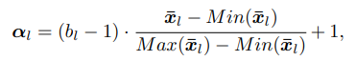
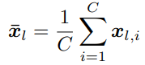
Free Lunch in Diffusion U-Net (FreeU)
The backbone factors: Introduce structure-aware scaling of backbone features and dynamically adjust the scaling of backbone features for each sample.
The scaling factor 𝛼l is calculated based on the average eigenvalue of the channel and then applied to some channels to avoid over-smoothing of the texture.
The backbone factor map
The average feature map along the channel dimension
bl: A scalar constant and bl > 1, used to amplify αl.
xl,i: The i-th channel of the backbone feature map xl in the l-th block of the U-Net decoder.
C: The total number of channels in xl.
12
Notes:
So,the Free Lunch in Diffusion U-Net (FreeU) was proposed.
First, we will introduce the operation of the backbone factors. The backbone factors introduce structure-aware scaling of backbone features and dynamically adjust the scaling of backbone features for each sample.
The scaling factor 𝛼l is calculated based on the average eigenvalue of the channel and then applied to some channels to avoid over-smoothing of the texture.
Left formula: This is the backbone feature adjustment formula, where αl represents the backbone factor map. bl is a scalar constant and bl is greater than 1.
Right formula: This is the average feature map along the channel dimension, where xl,i represents the i-th channel of the backbone feature map xl in the l-th block of the U-Net decoder. C denotes the total number of channels in xl.

Slide 14
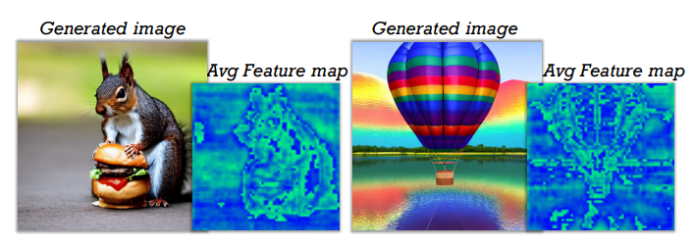
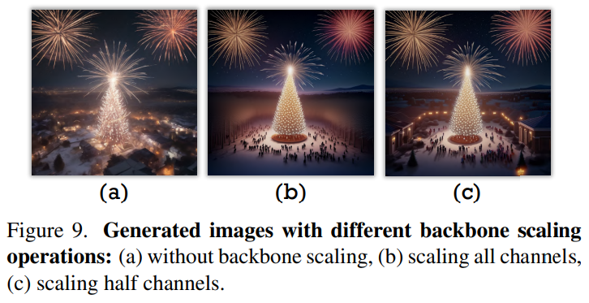
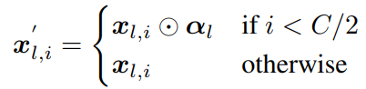
Visualization of average feature maps
⊙: Element-wise multiplication
13
Notes:
This is visualization displays the average feature maps along the channel dimension of backbone features.
Here we can observe that the synthesized images produced by part (b) has oversmoothed texture. It indiscriminately(無差別地) amplifies all channels of xl by multiplying αl.
Hence,they confine the scaling operation to the half channels of xl.
In this formula, If i is less than half C, multiply the backbone feature xi,l by αl to adjust the feature. Otherwise, keep the original xi,l without any adjustment.
I framed it with a red box. It can be clearly seen that b is scaling all channels has over-smoothing results.

Slide 15
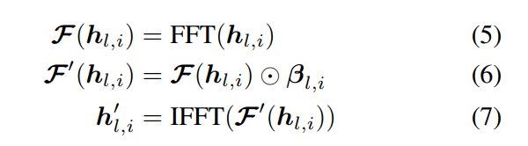
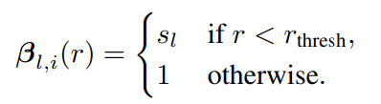
The skip factors: To alleviate the problem of over-smoothed textures, the skip features are Fourier transformed and spectral modulation is employed to selectively reduce the low-frequency components of the skip features.
hl,i: The i-th channel of the skip feature map in the l-th block of the U-Net decoder.
FFT(·): Fourier transform
IFFT(·): Inverse Fourier transform
βl,i : A Fourier mask, designed as a function of the magnitude of the Fourier coefficients
sl: Adjusting the low-frequency components of skip features in the Fourier frequency domain
r: The radius
r_{thresh}: The threshold frequency, set
to 1 in this experiments
14
Notes:
This part is the operation of skip factors. To alleviate the problem of over-smoothed textures, the skip features are Fourier transformed and spectral modulation is employed to selectively reduce the low-frequency components of the skip features.
Express mathematically that the operation is as left formula.
The formula on the right is β. which expresses that if the radius is less than threshold frequency, it will be suppressed by sl.
sl is adjust the low-frequency components of skip features in the Fourier frequency domain.

Slide 16
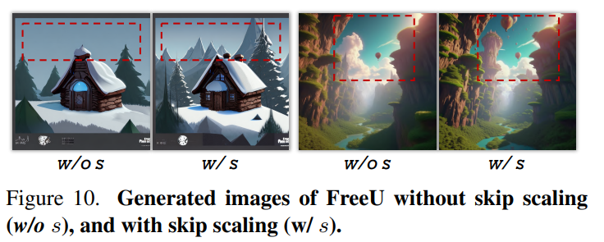
With skip scaling: By reducing low-frequency components of the skip features can generate better details.
15
Notes:
This figure is comparison of the without skip scaling and with skip scaling, it can be clearly observed that with skip scaling has more obvious details.
Because it will reduce the low-frequency components of the skip features.

Slide 17
3. Experiments
16

Slide 18
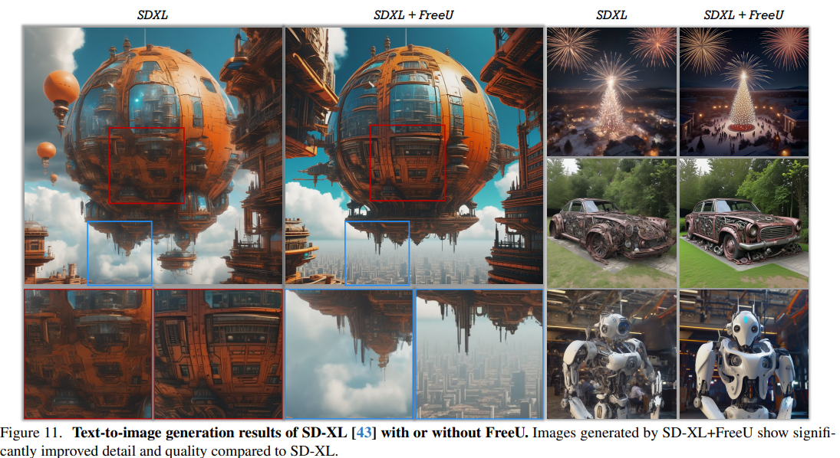
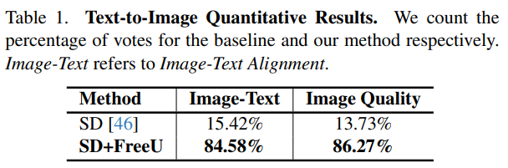
Text-to-Image Generation
Integrating FreeU into Stable Diffusion-XL, the results show that the generation capability is significantly enhanced.
17
Notes:
This part is Text-to-Image Generation.
By Integrating FreeU into Stable Diffusion-XL, Stable Diffusion is a latent text-to-image diffusion model renowned for its capability to generate photorealistic images based on textual input, the figure 11 show that the generation capability is significantly enhanced.
In addition, they also conducted a quantitative evaluation. They gave 120 participants a text prompt and two composite images, one was SD and the other was SD+FreeU, and asked to choose which image they considered superior in terms of image-text alignment and quality.
Table 1 is the result of voting. It can be seen that FreeU is better than SD in image quality and image-text alignment.

Slide 19
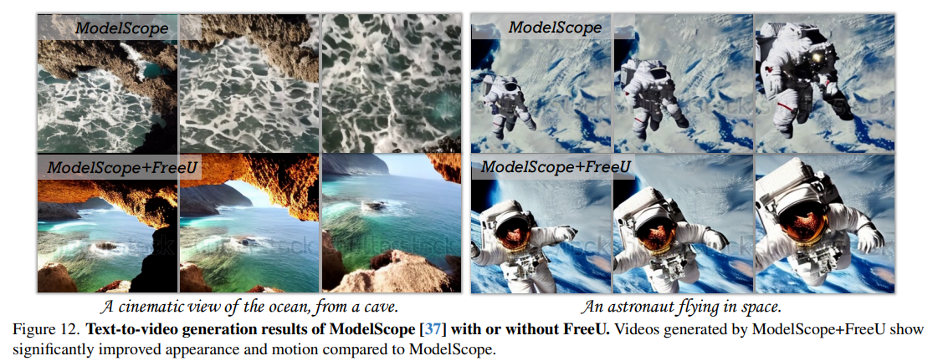
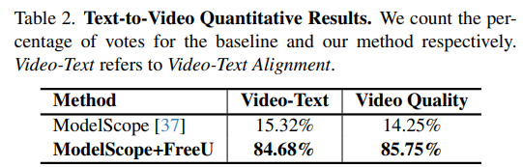
Text-to-Video Generation
Injecting FreeU into ModelScope can further hone video synthesis capabilities.
18
Notes:
In the Text-to-Video Generation,they injected FreeU into ModelScope can further hone video synthesis capabilities, the ModelScope is a text-to-video diffusion model, stands at the forefront of video generation from textual descriptions.
It can be seen from figure12 that ModelScope plus FreeU shows significantly improved appearance and motion compared to ModelScope.
The table 2, similar to the previous page, quantitative evaluation of text-to-video conversion. It is obvious that most participants prefer the video generated with FreeU

Slide 20
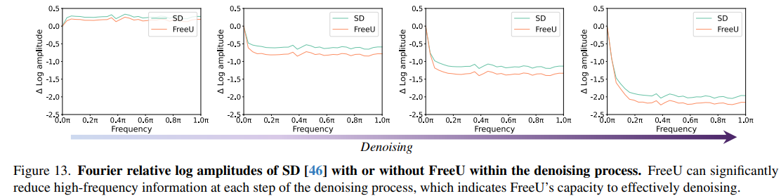
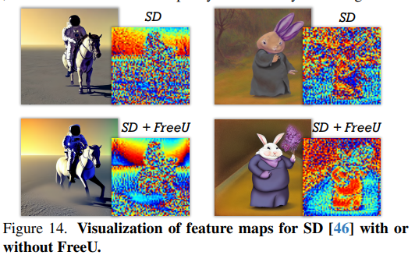
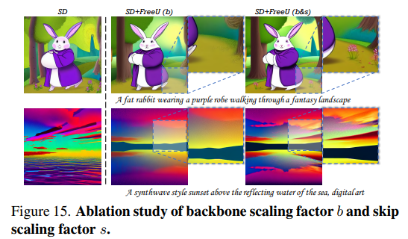
Ablation Study
19
Notes:
In the Ablation Study
Figure13 shows Fourier relative log amplitudes of SD with or without FreeU within the denoising process, we can see that FreeU can reduce high-frequency information at each step of the denoising process.
In figure14, we observe that the feature maps produced by FreeU contain more obvious structural information.
Figure 15 shows the results of introducing the backbone feature scaling factor b and the skip feature scaling factor s. It can be observed that SD+FreeU(b) produces a rabbit with normal arms and ears. Although it is improved, it occasionally leads to over-smoothing. So s is introduced to solve this problem.
We can see that the combination of SD+FreeU(b&s) produces more realistic images.

Slide 21
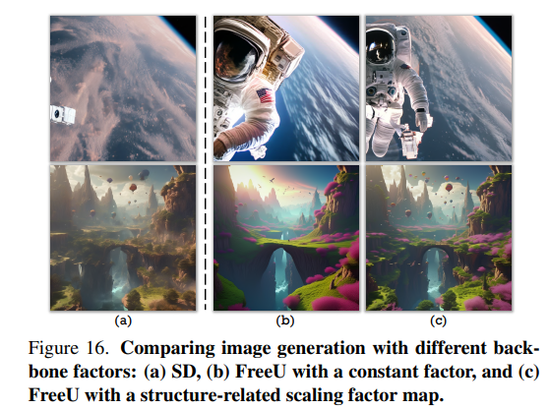
20
Notes:
Figure 16 is a comparison of image generation with different backbone factors.
Here we observe that the image quality of FreeU with constant factor in part b is better than SD, but there will be over-smoothing of textures and poor color oversaturation. See again part (c), FreeU with structure-dependent scaling factor graph effectively alleviates these problems using adaptive scaling.

Slide 22
4. Conclusion
21

Slide 23
Backbone helps in denoising, while skip connections mainly introduce high-frequency features into the decoder, which may lead to ignoring the basic backbone semantics.
A simple and efficient method, FreeU, is proposed to significantly enhance the generation quality of diffusion models by balancing the proportion of U-Net backbone and skip features.
No additional training or fine-tuning is required, which can greatly improve the quality of diffusion model samples.
22
Notes:
The conclusion is summarized in the following three points:
The advantages of FreeU are no additional training or fine-tuning is required, which can greatly improve the quality of diffusion model samples.

Slide 24
Thank you for listening

